Slide 1
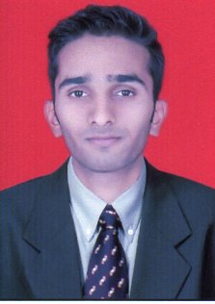
ADITYA RAHATEKAR
Name : Aditya Rahatekar
Job Title/Level :Technical specialist: Trainee
Tieto Tenure :1 Month
Total Experience :Fresher
Qualification :B.E (Electronics)
Motivators for engagement
New Technology.
Milestone towards SME.
Work Culture.
Best opportunity for carrier.
Highlights
I have completed B.E in Electronics.
Cisco Certification course.
Microsoft Certification course.
Red-hat Certification course.
Good knowledge of html and its scripting.
Accomplishments/Achievements/Awards
Career Interests
Automation & orchestration
DevOps
SME in Data Security
Strengths
Learning Attitude
Solution Oriented
Team player
Personal interests/Hobbies
Using Gadgets
Tracking and Travelling
cricket

